Slide 1

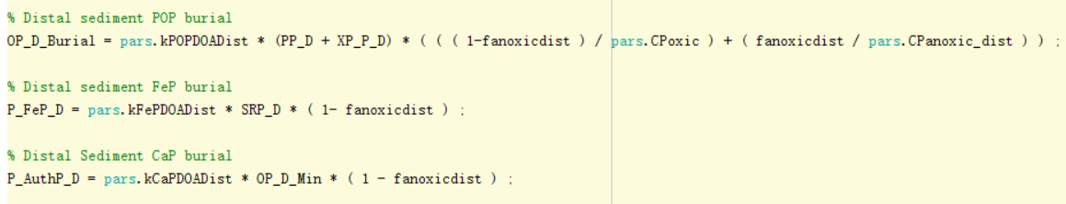
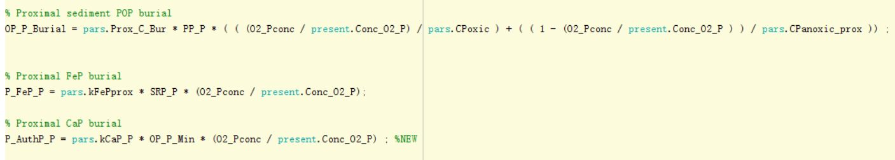
Here's how to remove Fanoxic
Before we use,
Now we use,

Slide 2
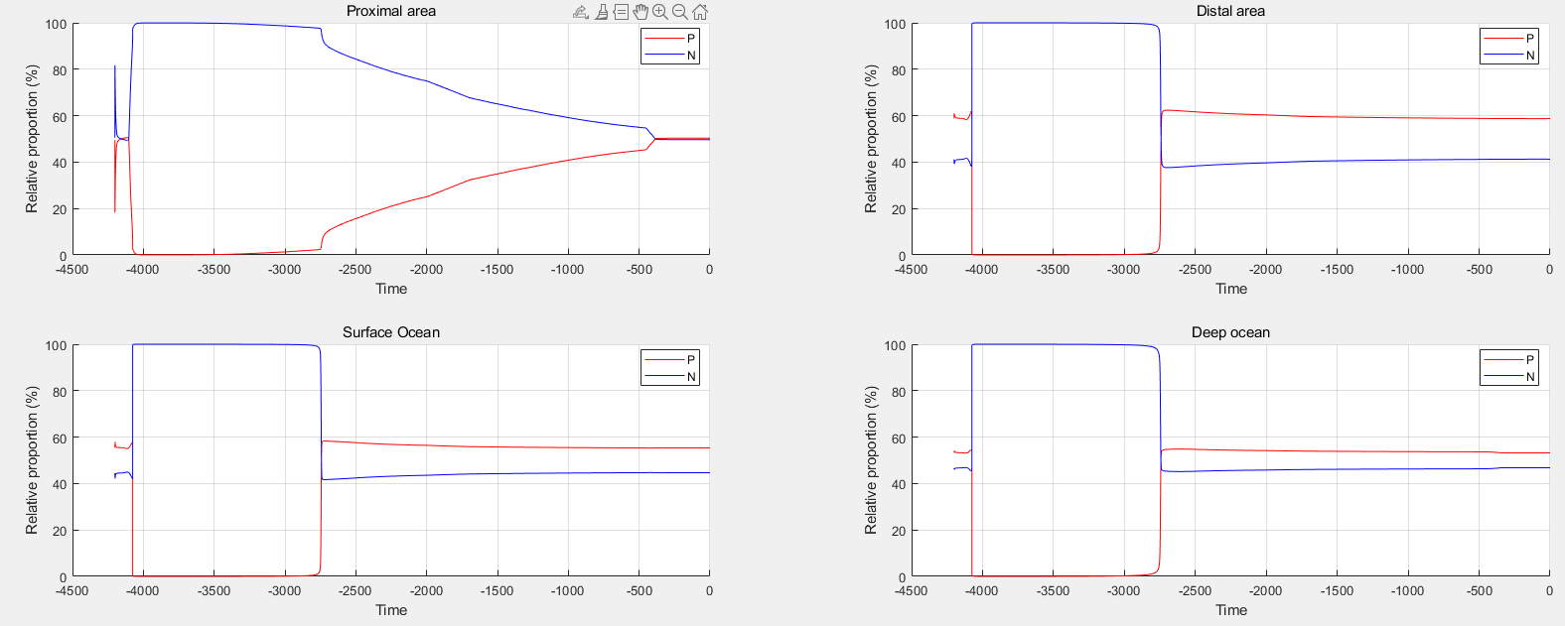

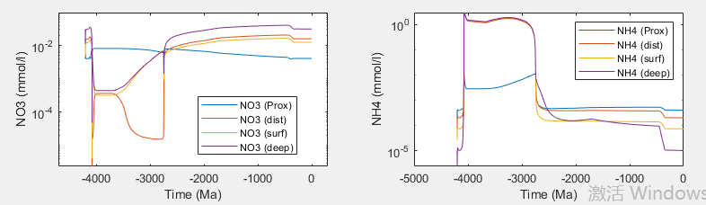
Running the model, we then found that the N in the proximal box seemed to be consistently high?
Code
It is assumed that because the river N input is fixed value, too much N is input in the early stage

Slide 3
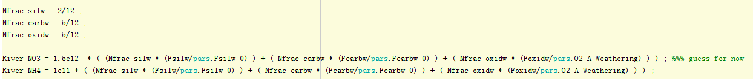
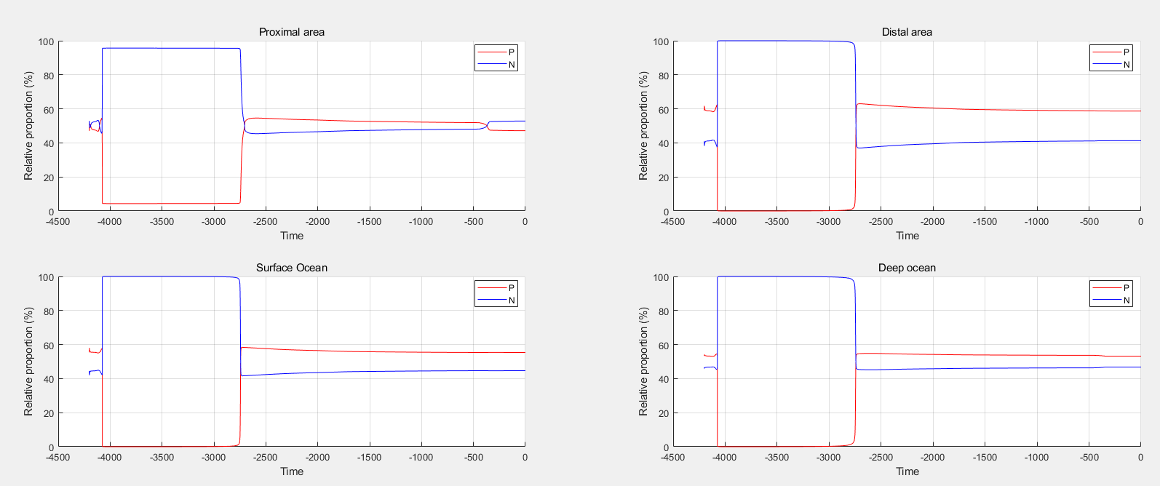
So I modified the code for the river N input, but I did it exactly like the river P input.
I didn't know how to properly design the N weathering, and with the following code, I rerun the model
Fortunately the N in the Proximal box dropped after GOE, I don't know if this is feasible and need your advice.

Slide 4
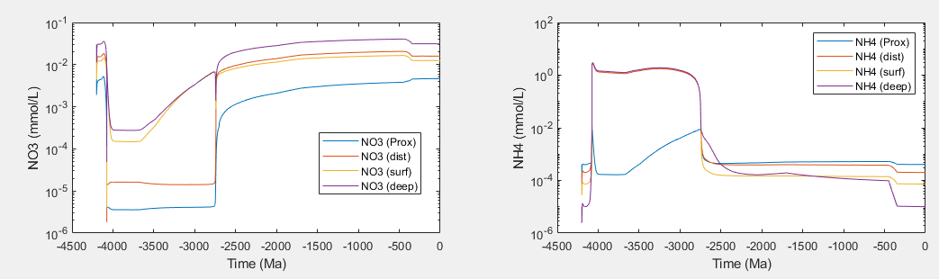
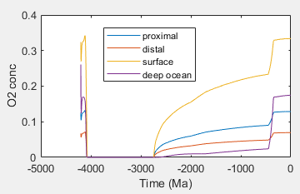
This is the concentration of NO₃⁻, NH₄⁺, O₂ obtained according to the following code,
Denitrification and nitrification , a example in Proximal box
Oxygen is extremely low before GOE, so the nitrification flux is extremely low, resulting in higher NH₄⁺ accumulation before GOE. Doesn't make much sense

Slide 5
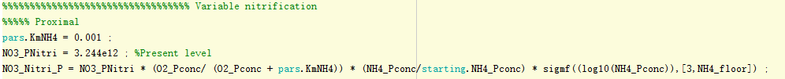
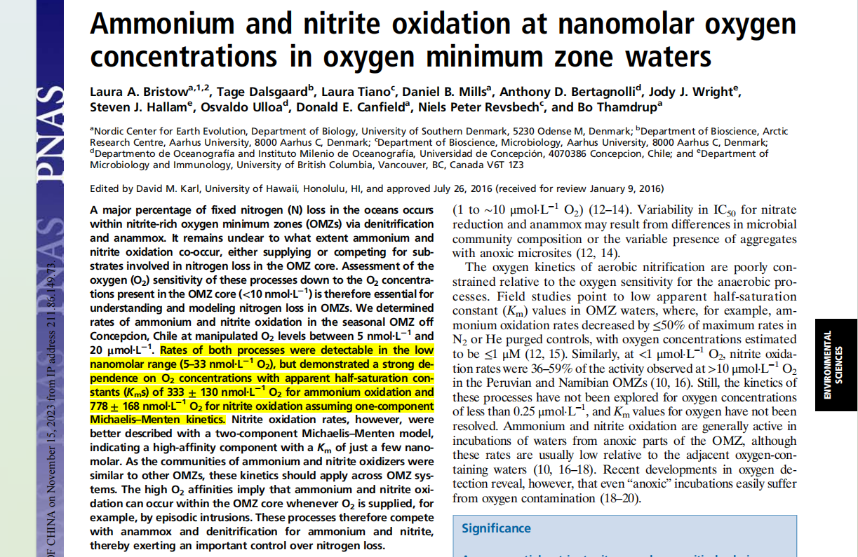
I'm not sure if this is reasonable, but I learned it from the ming model. Define the effect of oxygen on nitrification by setting half-saturation parameters. But I think this idea is supported by modern research that nitrification can occur even at very low oxygen concentrations (10 nmol/L).
ming model

Slide 6
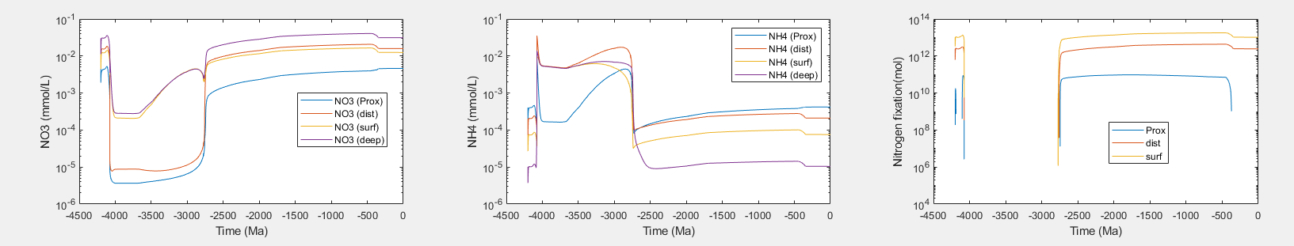
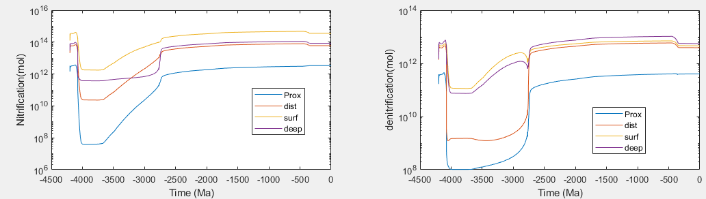
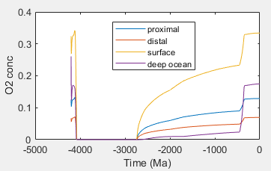
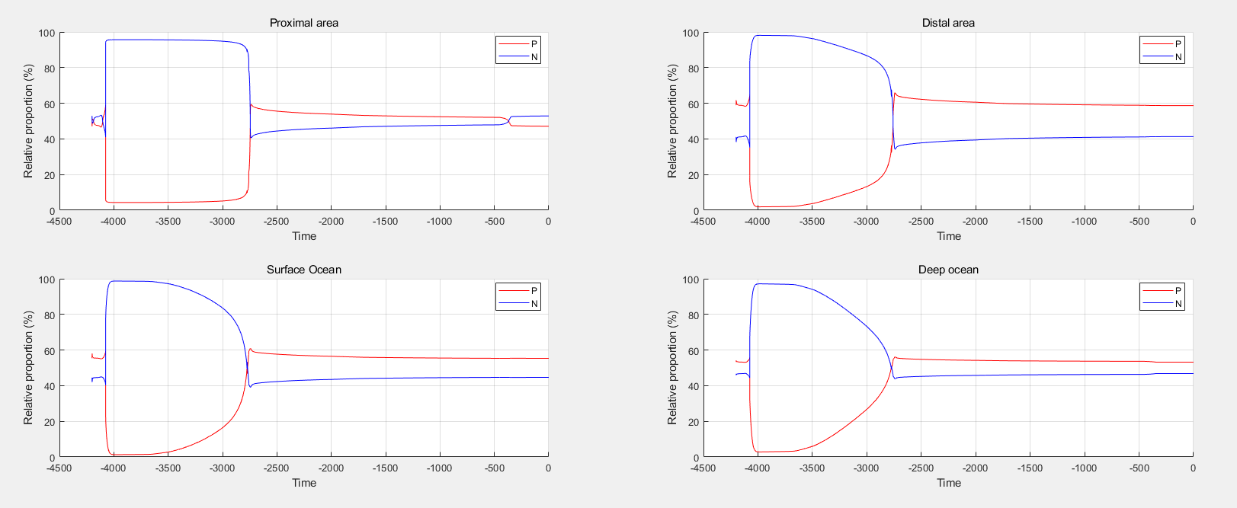
After trying to change the nitrification code and re-running the model, the NH4+ concentration was more reasonable, at the umol/L level.
But as the figure above shows, the concentration of NO3- was still too high in the Proterozoic, exceeding that of the modern ocean. The current denitrification code is like this, so I tried to adjust it.
Note that after adjusting the nitrification code, the relative proportion of phosphorus increased gradually and did not change suddenly during the GOE as before (The third slide).

Slide 7
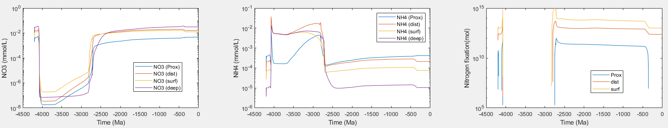
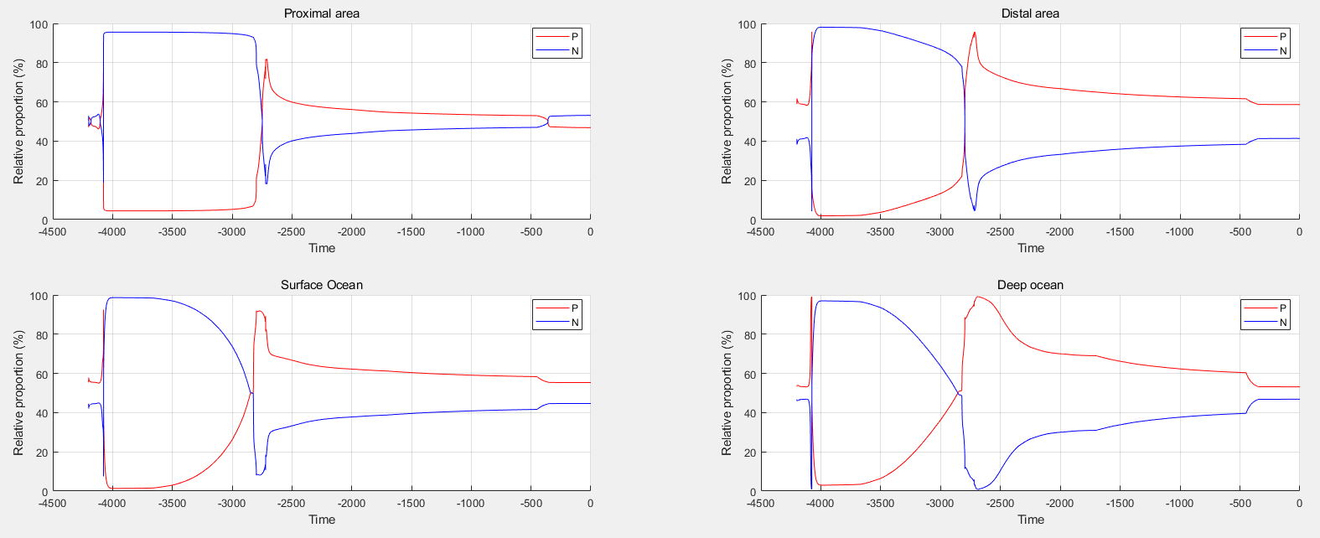
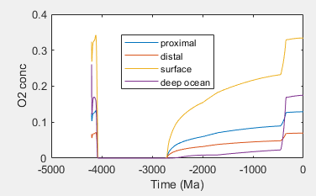
I changed the code for denitrification, as shown below, changing the oxygen part
Although we see a stronger nitrogen restriction in the proterozoic, this modification seems problematic. When O2 concentration is very low, denitrification is amplified too much

Slide 8
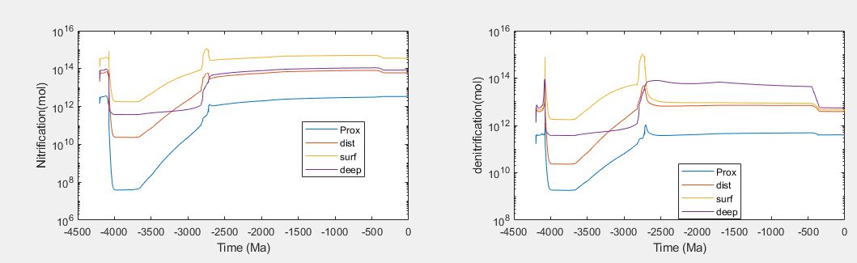
This is the result immediately following the previous slide, as expected, the denitrification flux is high, exceeding modern oecan, so I'm not sure if this is reasonable

Slide 9
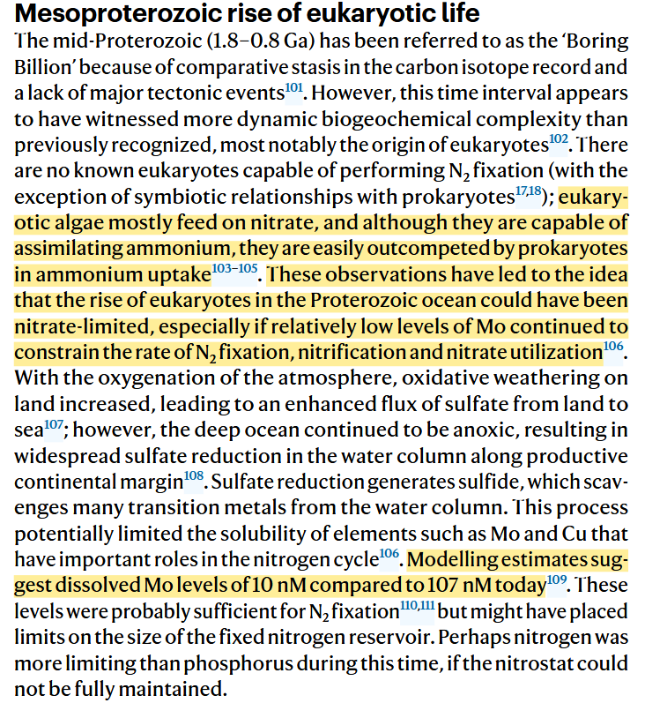
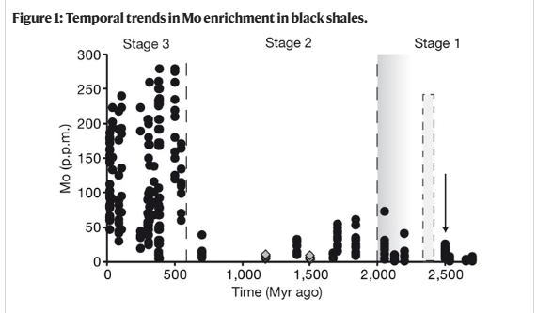
Personally, I think the current problem is that the results of NO3- are not very reasonable. An attempt was made to modify the denitrification function, but it was not quite correct either. Some nitrogen fluxes in the Precambrian ocean exceeded those in the modern ocean.
Another idea is the formation of euxinia in the Proterozoic (unfortunately, there is no sulfur cycle in the model), which removed the trace element Mo from seawater. As one of the key synthetic elements of nitrogenase, the change of Mo affects the rate of nitrogen fixation. Therefore, the rate of nitrogen fixation in the Proterozoic was not high, resulting in nitrogen limitation. In our results, nitrogen fixation in the proterozoic also exceeded that in the modern ocean, which is also a possible reason for the high level of NO3- in the Proterozoic. So, I don't know if this idea is useful to us, there's a lot of research on the concentration of trace element Mo that might help.

Slide 10
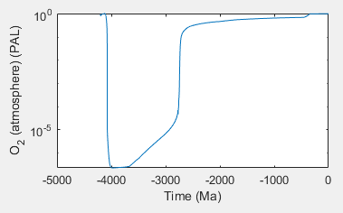
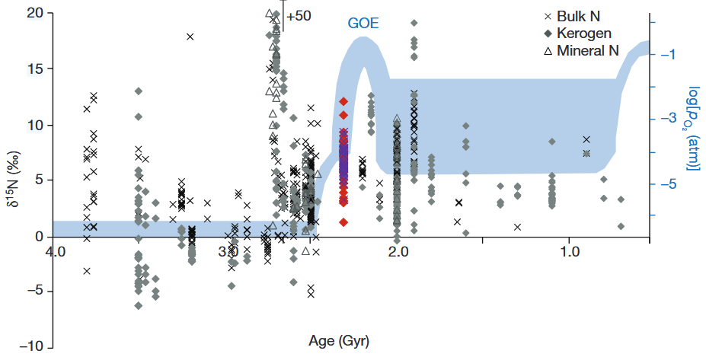
It is generally believed that atmospheric oxygen levels in the Proterozoic were 1-10% of modern atmospheric levels, whereas our current model results indicate that oxygen levels in the Proterozoic reached 30-40% of modern levels。
If nitrogen restriction occurred in the Proterozoic, then the concentration of nitrogen should have controlled primary production, resulting in lower oxygen. At the same time, the restriction of NO3- also hindered the prosperity of eukaryotes. Until after NOE, oxygen rose again, and NO3- reservoir was further increased. Eventually, eukaryotes also occupied the dominant niche during NOE, completing the transition to modern oceans.

Slide 11
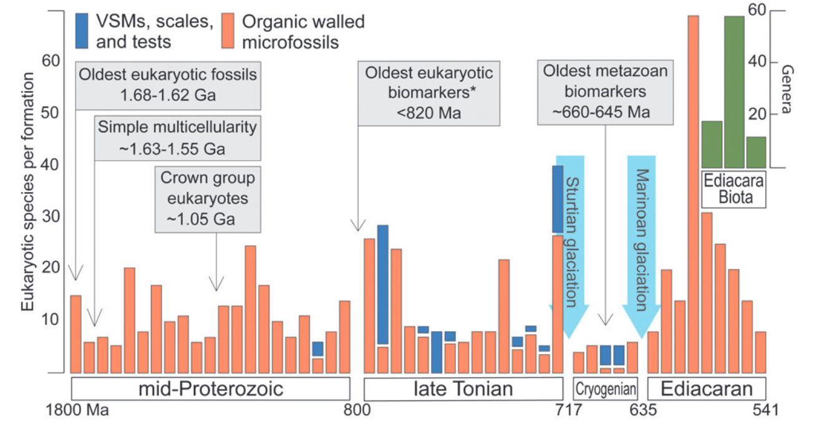
What we discussed last time
From the study of the geological record, it is found that the P limit or N limit in the proterozoic is very controversial.
The P limitation idea is that deep ocean water is ferruginous and so still removes most of the P from the water column.
The N limitation idea is that the first eukaryotic record appeared at 1.6Ga and did not flourish until after 0.8Ga (NOE). Many views suggest that this is due to NO3- limitation, since eukaryotes primarily assimilate NO3- rather than NH4+. In the same time, there are also many studies that show an increase in NO3- availability around 0.8Ga, however, our results do not find this, and the deep sea and surface NO3- are somewhat high in the Proterozoic period.

